Slide 1

CSE 586: Project 2 3D Reconstruction
Group members: Hong Zhang, Shimian Zhang, Wenxing Cao, Yaqi Xu

Slide 2
Project Statement
Goal: Implement an augmented reality viewer that displays artificial objects overlaid on images of a real 3D scene.
Tasks: RANSAC, Coordinate systems and Geometric Transformations (e.g., rotation and translation to map points between coordinate systems)
Dataset: Photos taken by ourselves where the dominant planar surface is ground

Slide 3
Project flow chart
Input: A set of images
Step 2:Dense Reconstruction
Step 3:Read in 3D point cloud
Step 4:RANSAC routine
Step 5:Display 3D point cloud
Step 6:Geometric Transformation
Step 7:Create virtual object
Step 8:Internal & External parameters
Step 9:Projects 3D points->2D points
Virtual object in the image

Slide 4
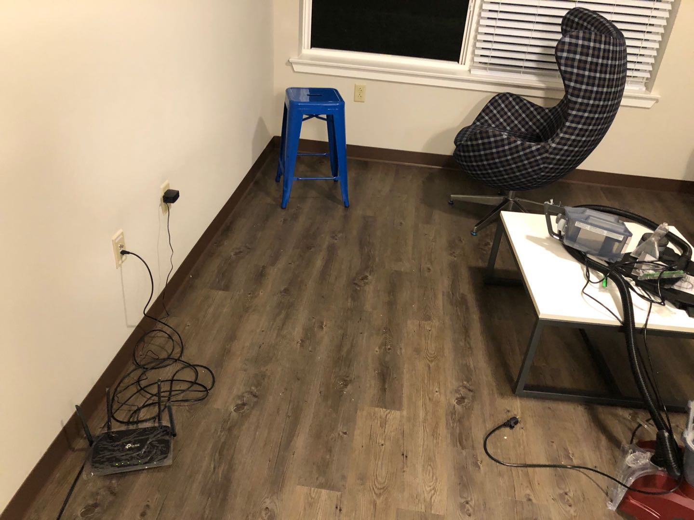
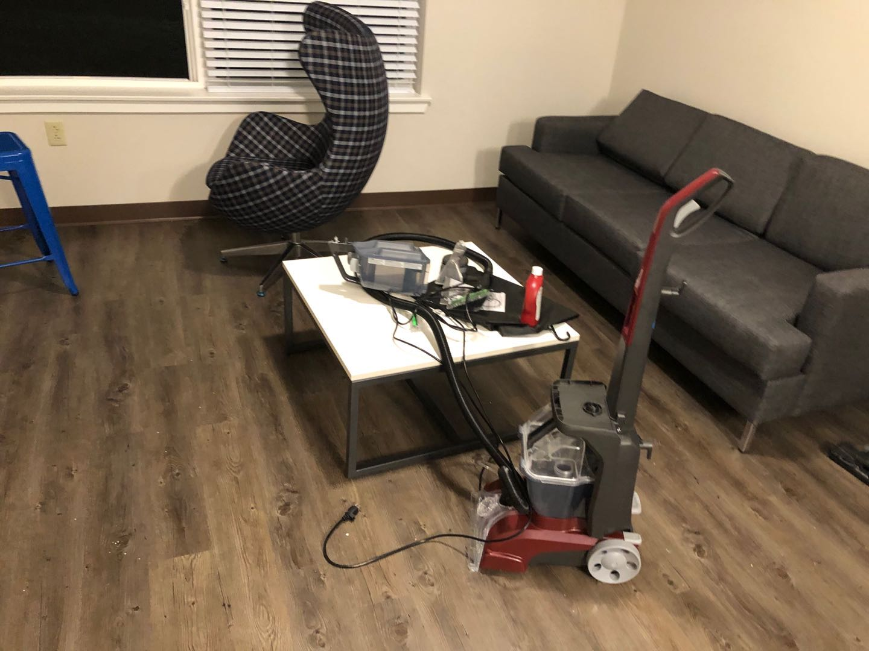
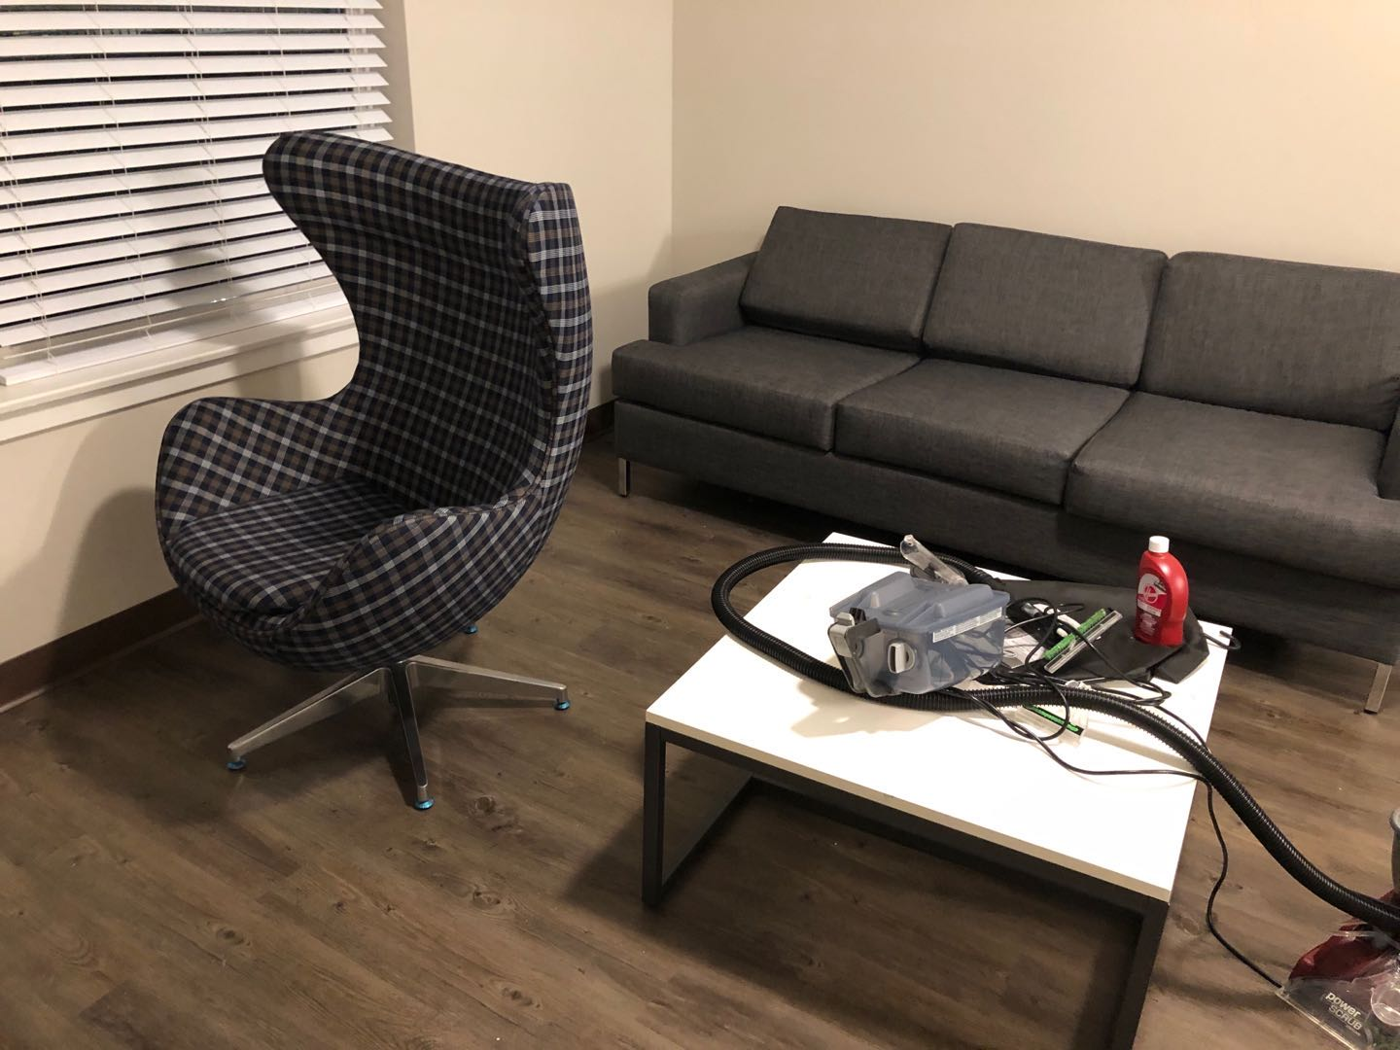
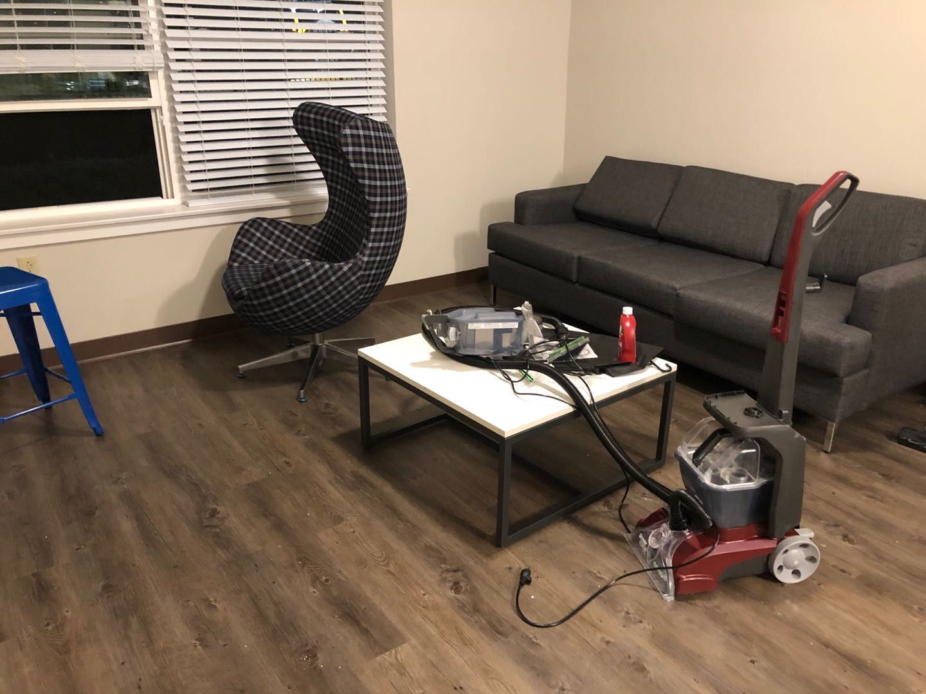
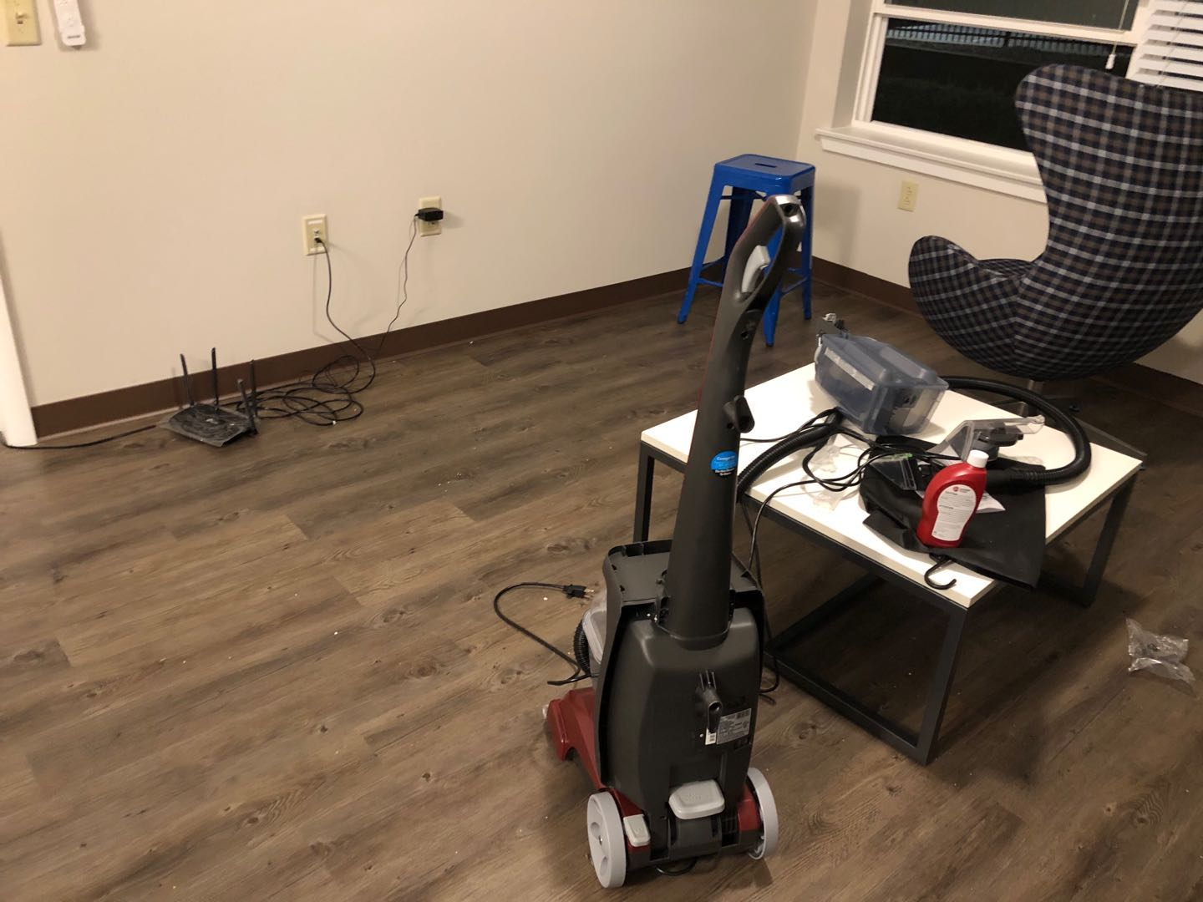
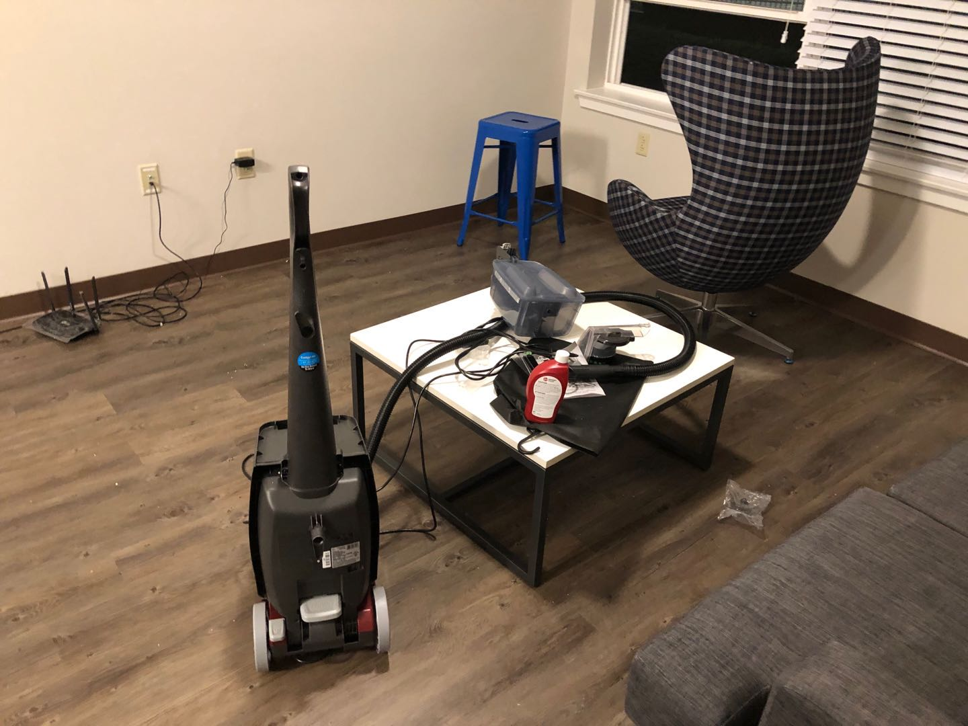
Step 1: Input a set of images
---We took 16 photos around this scene, here are some of them

Slide 5
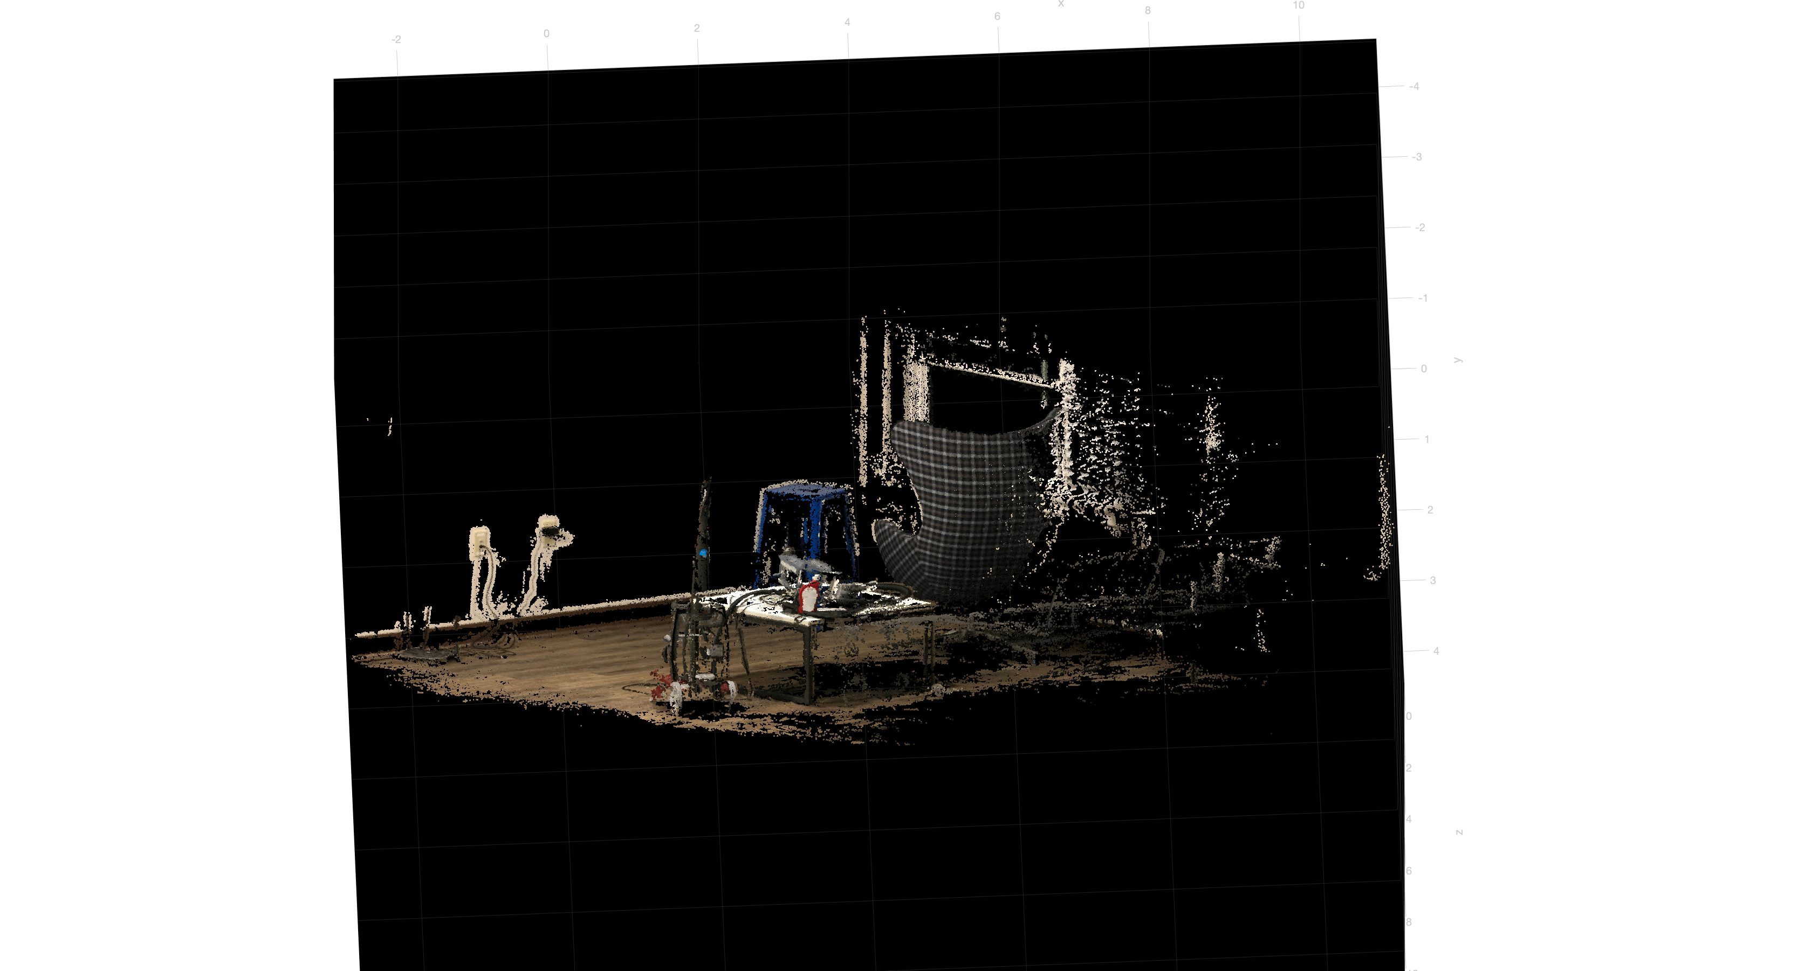
Step 2: “Dense” Reconstruction
---After running COLMAP, we pick ”dense” 3D points cloud instead of “sparse”, because it looks clearer to present.

Slide 6
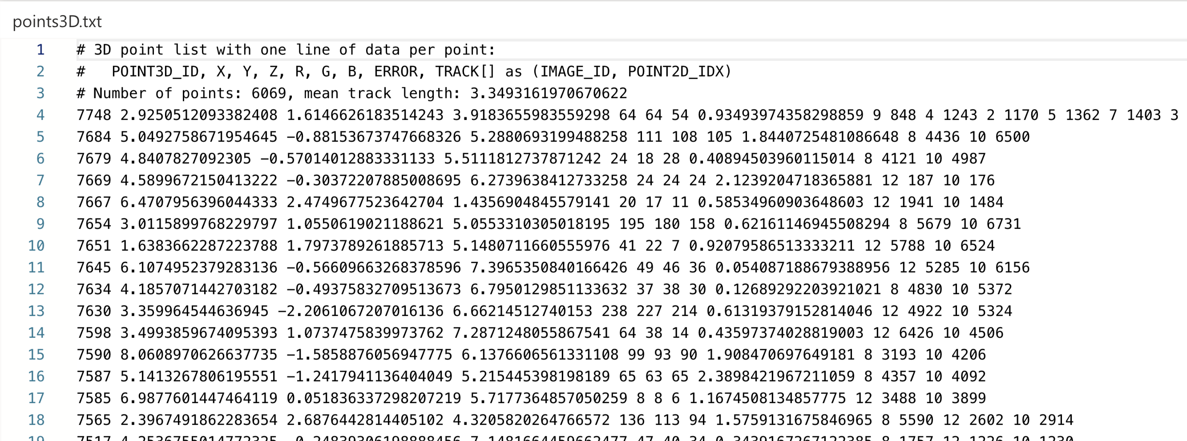
Step 3: Get the X,Y,Z coordinates for each point
---From the exporting of last step, we get 3 text files: cameras.txt, images.txt and points3D.txt. X,Y,Z coordinates of points are in the points3D.txt.

Slide 7

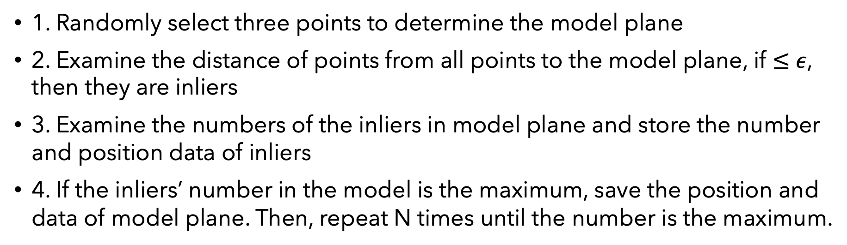
Step 4: Write RANSAC to find dominant plane
---The RANSAC algorithm → general parameter estimation approach → to remove outliers
1. Randomly select three points to determine the model plane
2. Examine the distance of points from all points to the model plane, if $≤$ $ε$, then they are inliers
3. Examine the numbers of the inliers in model plane and store the number and position data of inliers
4. If the inliers’ number in the model is the maximum, save the position and data of model plane. Then, repeat N times until the number is the maximum.
$$N=\frac{log⁡(1−p)}{log⁡[1−{(1−e)}^{s}]}$$

Slide 8
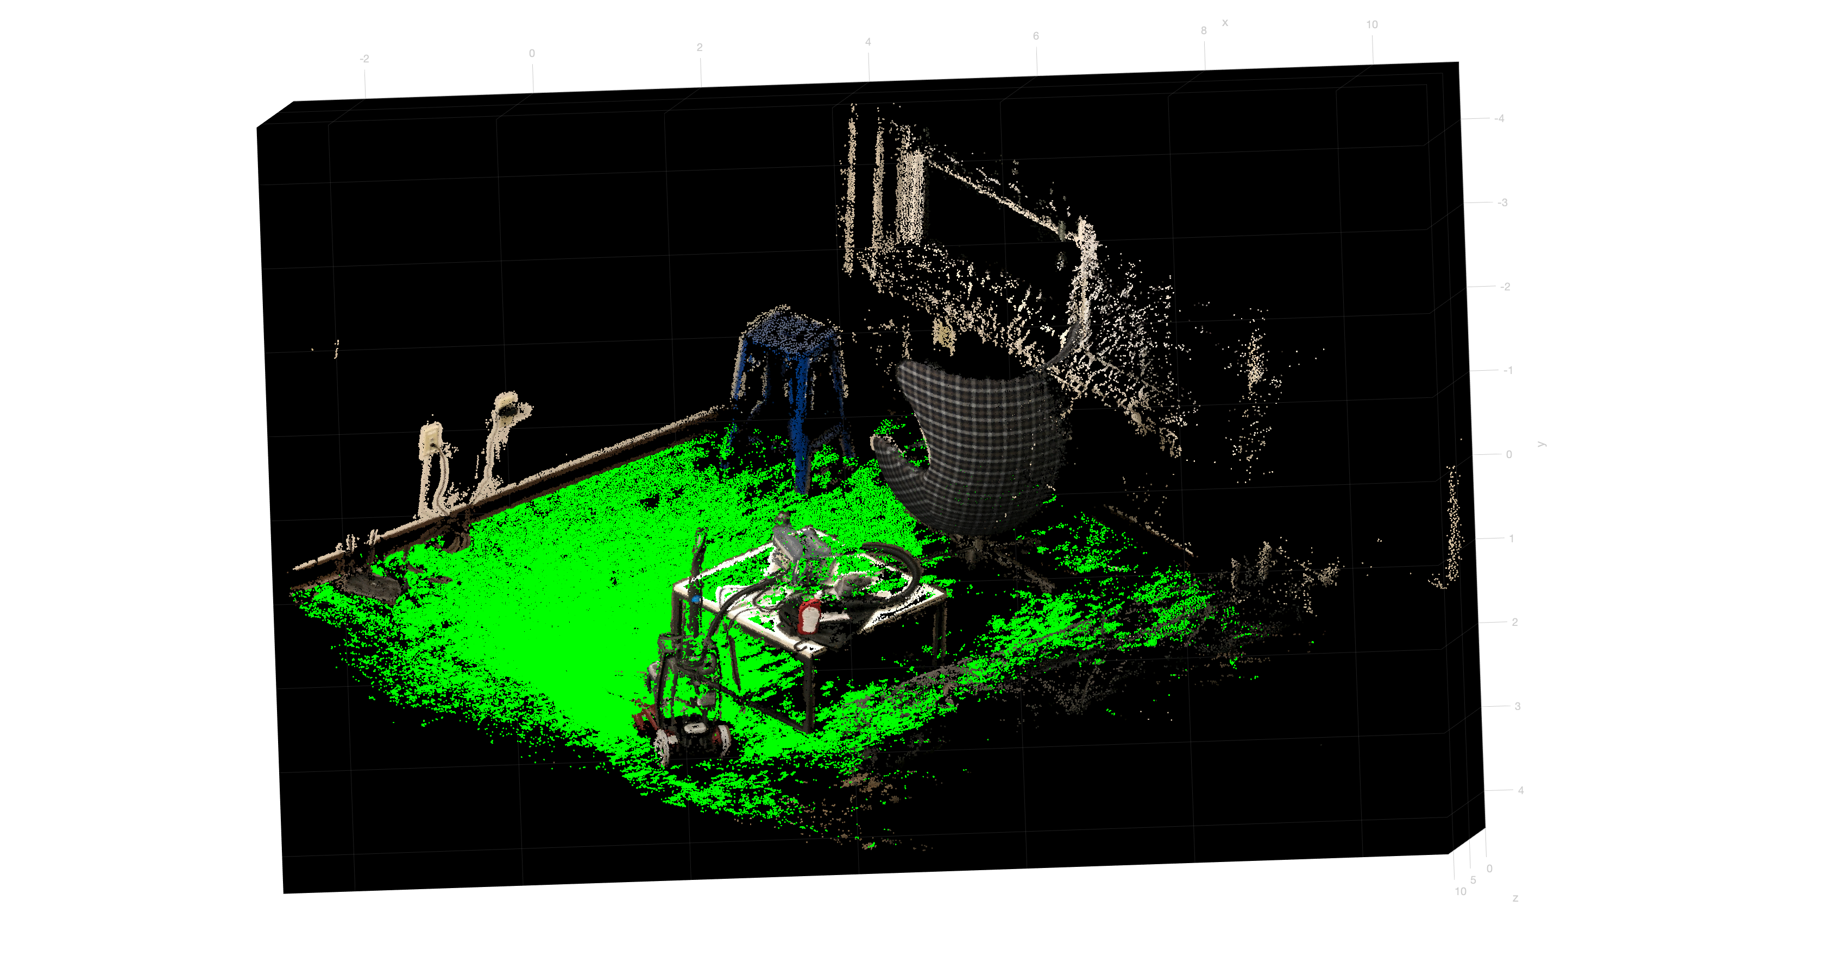
Dominant plane from from Camera View

Slide 9
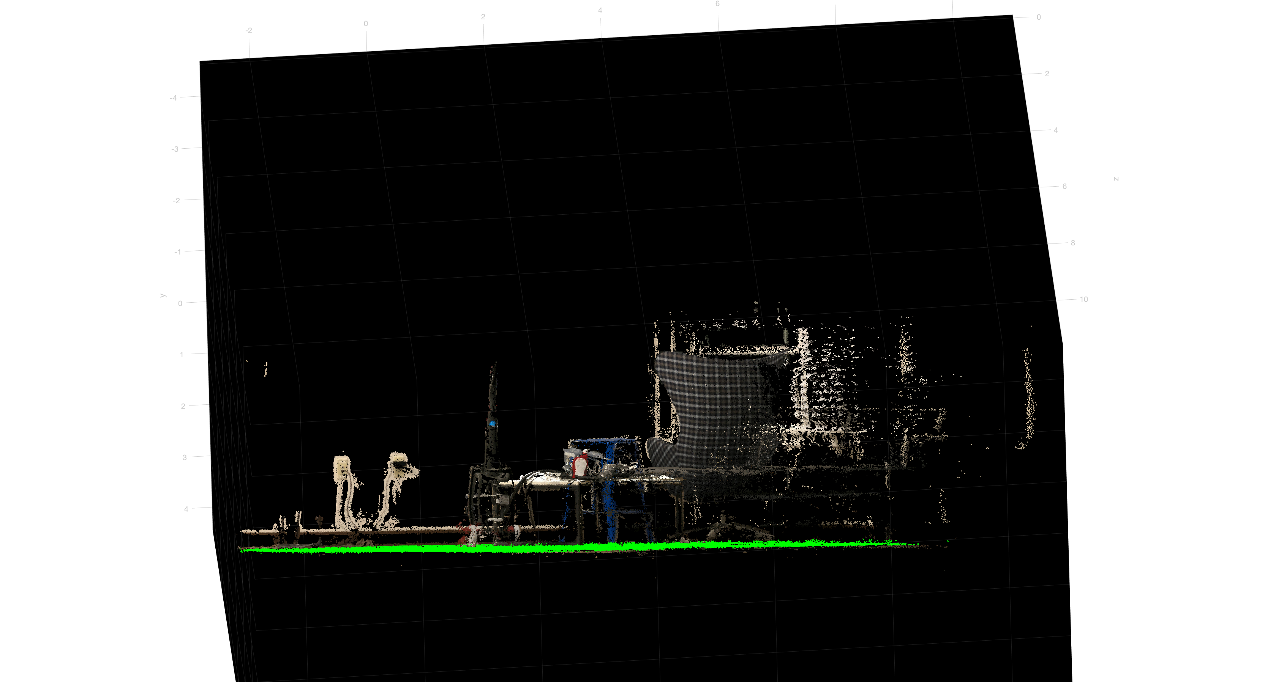
Dominant plane from Horizontal View

Slide 10
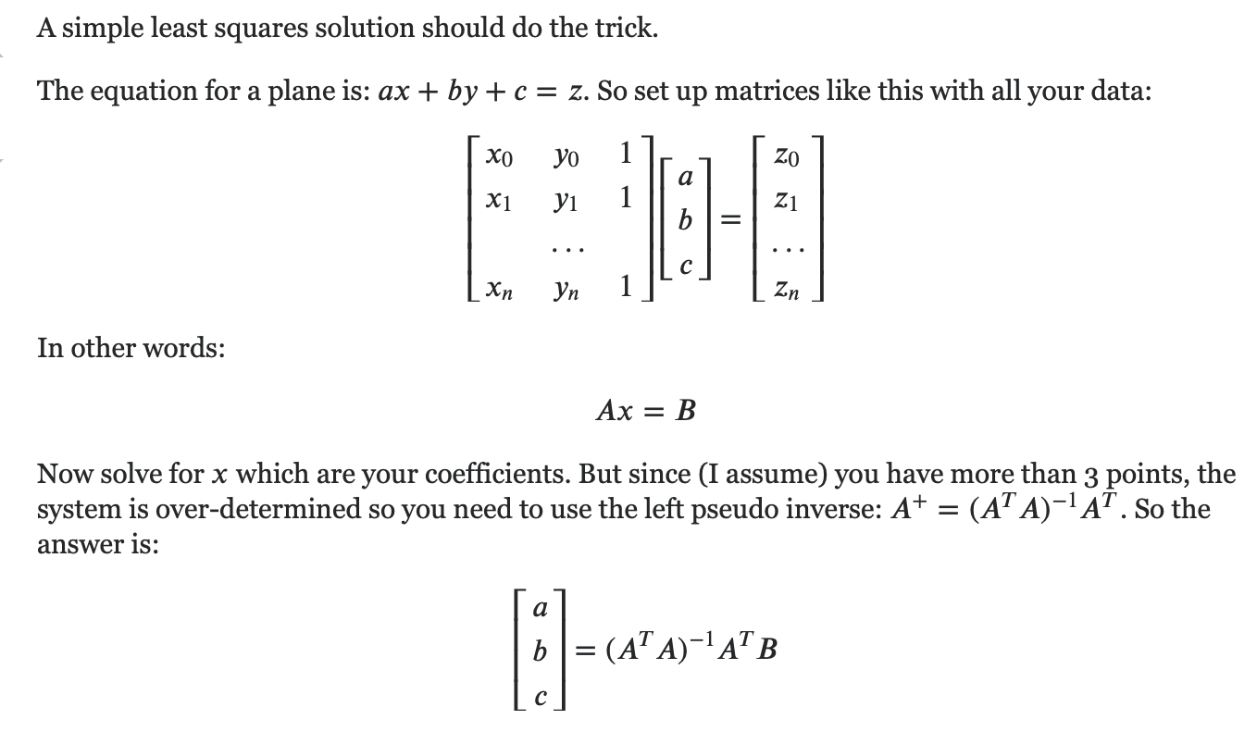
Step 5: Display the refined dominant plane
---Here is our trick (pick c = 1, suitable for this case) to solve the problem of fitting plane, which is to form a smooth plane.

Slide 11
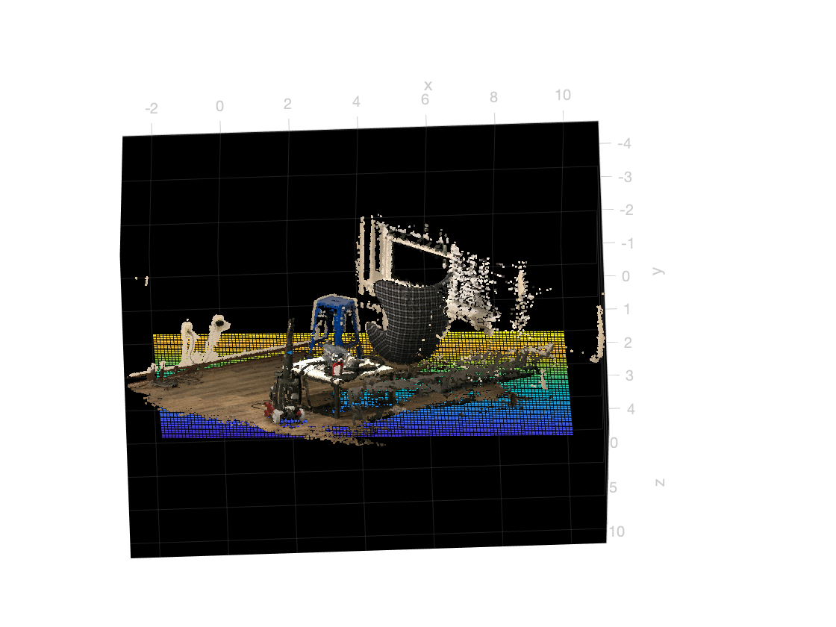
Refined dominant plane after computing the plane parameters [X(1), X(2), 1, X(3)] from equations above

Slide 12
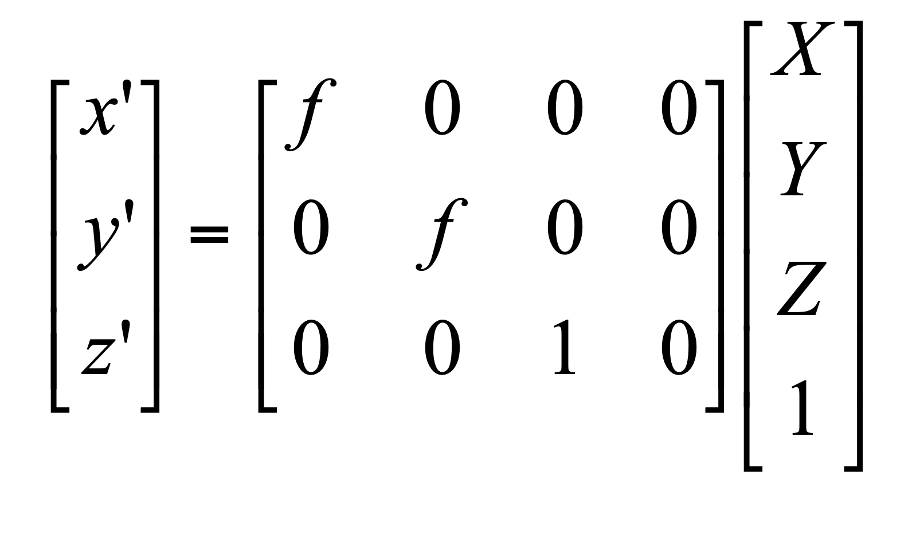
Step 6: Homogeneous Coordinate System & Geometric Transformations
1. Homogeneous Coordinates are used to represent a 2D point (x, y) by a 3D point (x’, y’, z’) by adding a “fictitious” third coordinate.

Slide 13
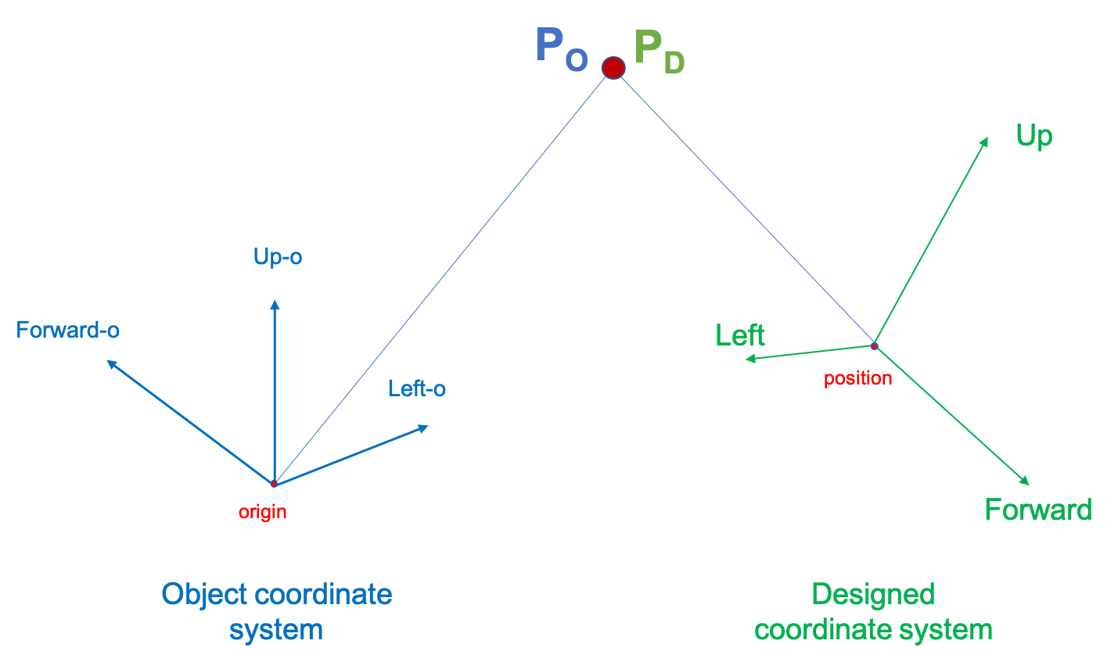
2. During the forward projection, rigid transformations are needed between object and designed coordinate systems.
P_{C} and P_{W} are the same physical point (not two different point), described in the object coordinate system and designed coordinate system.

Slide 14
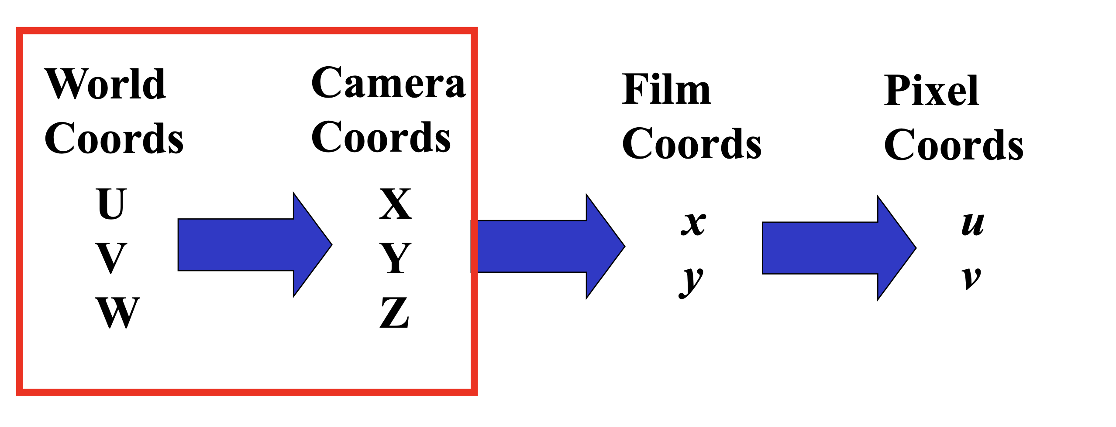
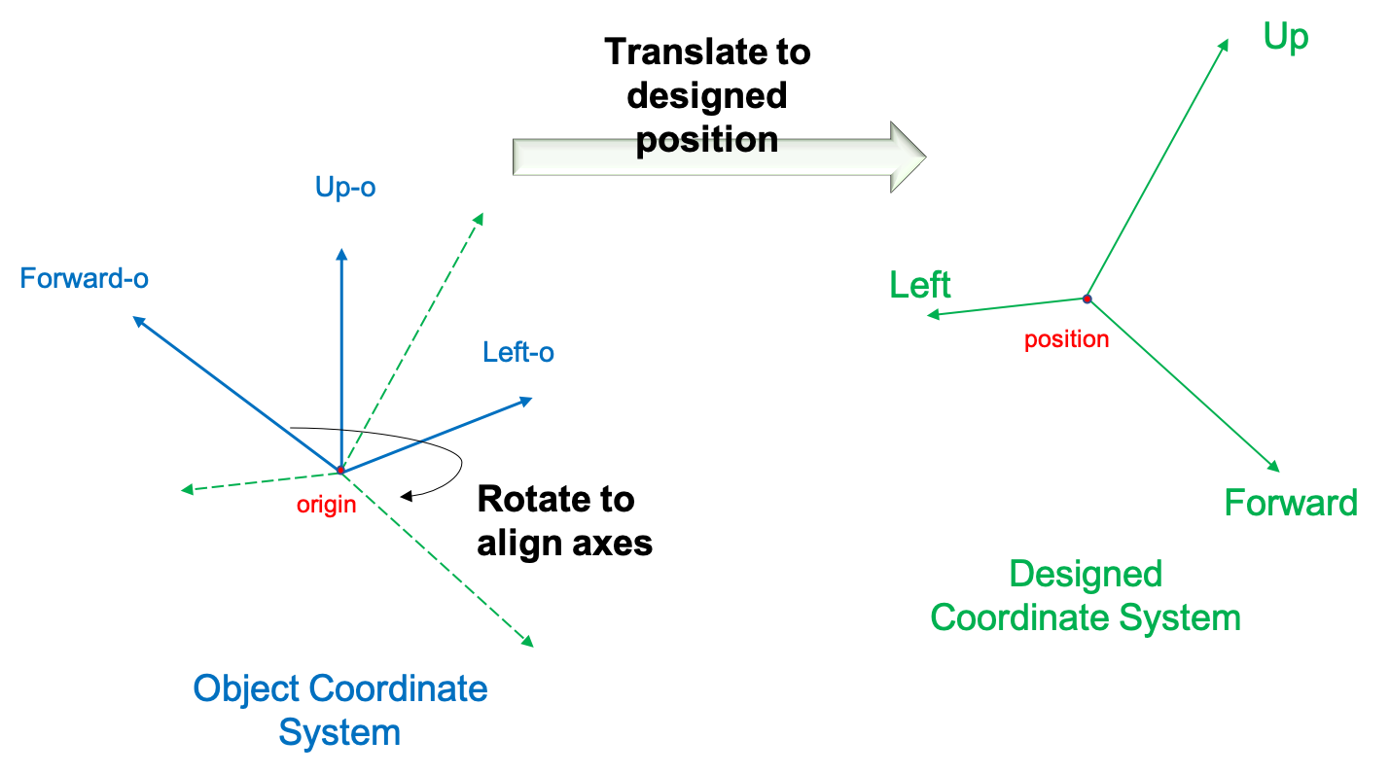
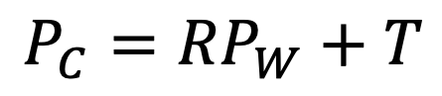
$$P_{C}={RP}_{W}+T$$
First rotate the object’s local coordinate system to the same direction as the designed coordinate system, then translate it to the designed position.

Slide 15
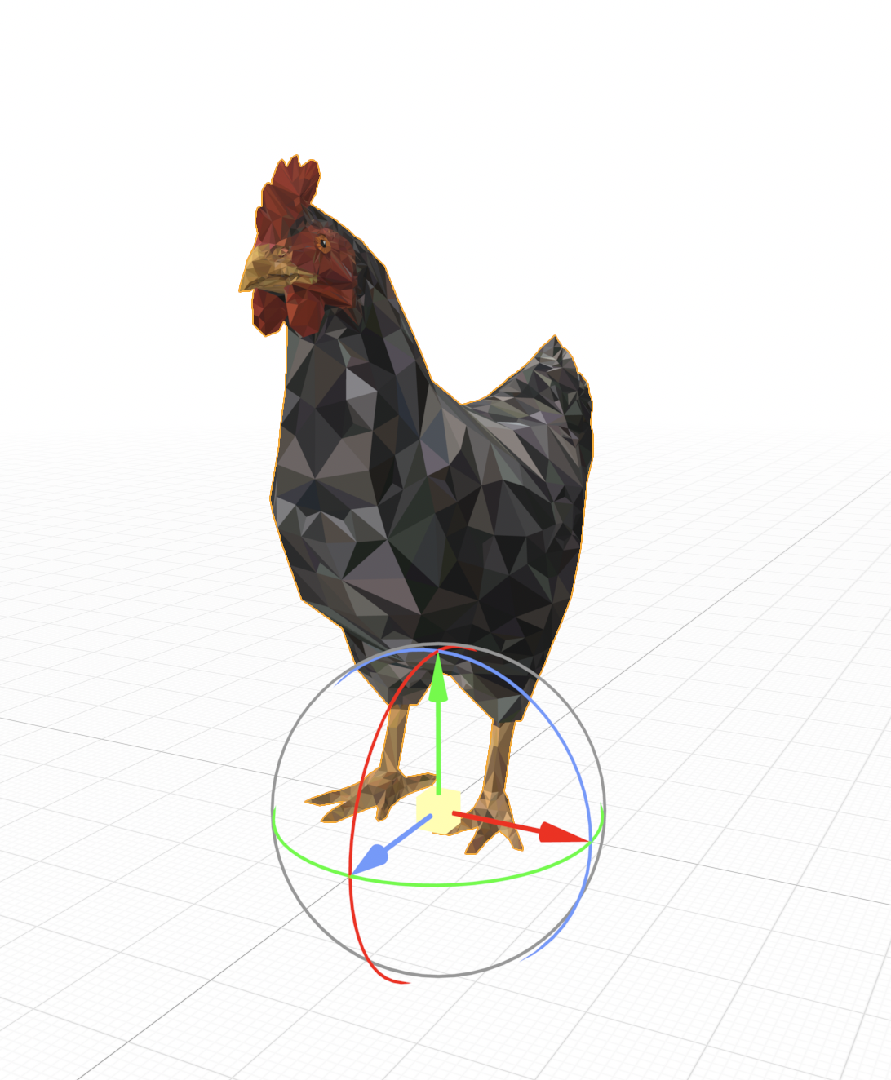
Step 7: Create a Virtual Object
1. Set the local coordinate system of the object [Up, Forward, Left] and its origin is around the origin of world coordinate system after being imported into the point cloud. (Note: the UP axis is parallel to the normal vector of plane and Forward axis is for the object to face the viewer)

Slide 16
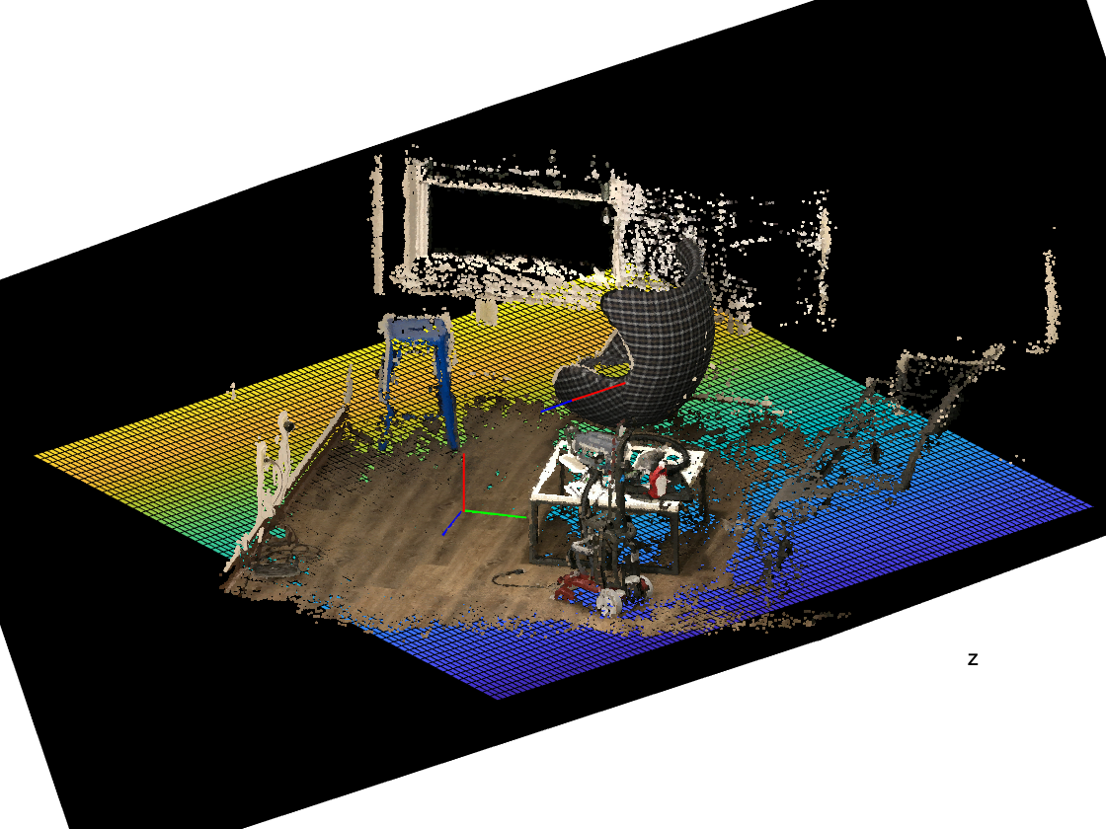
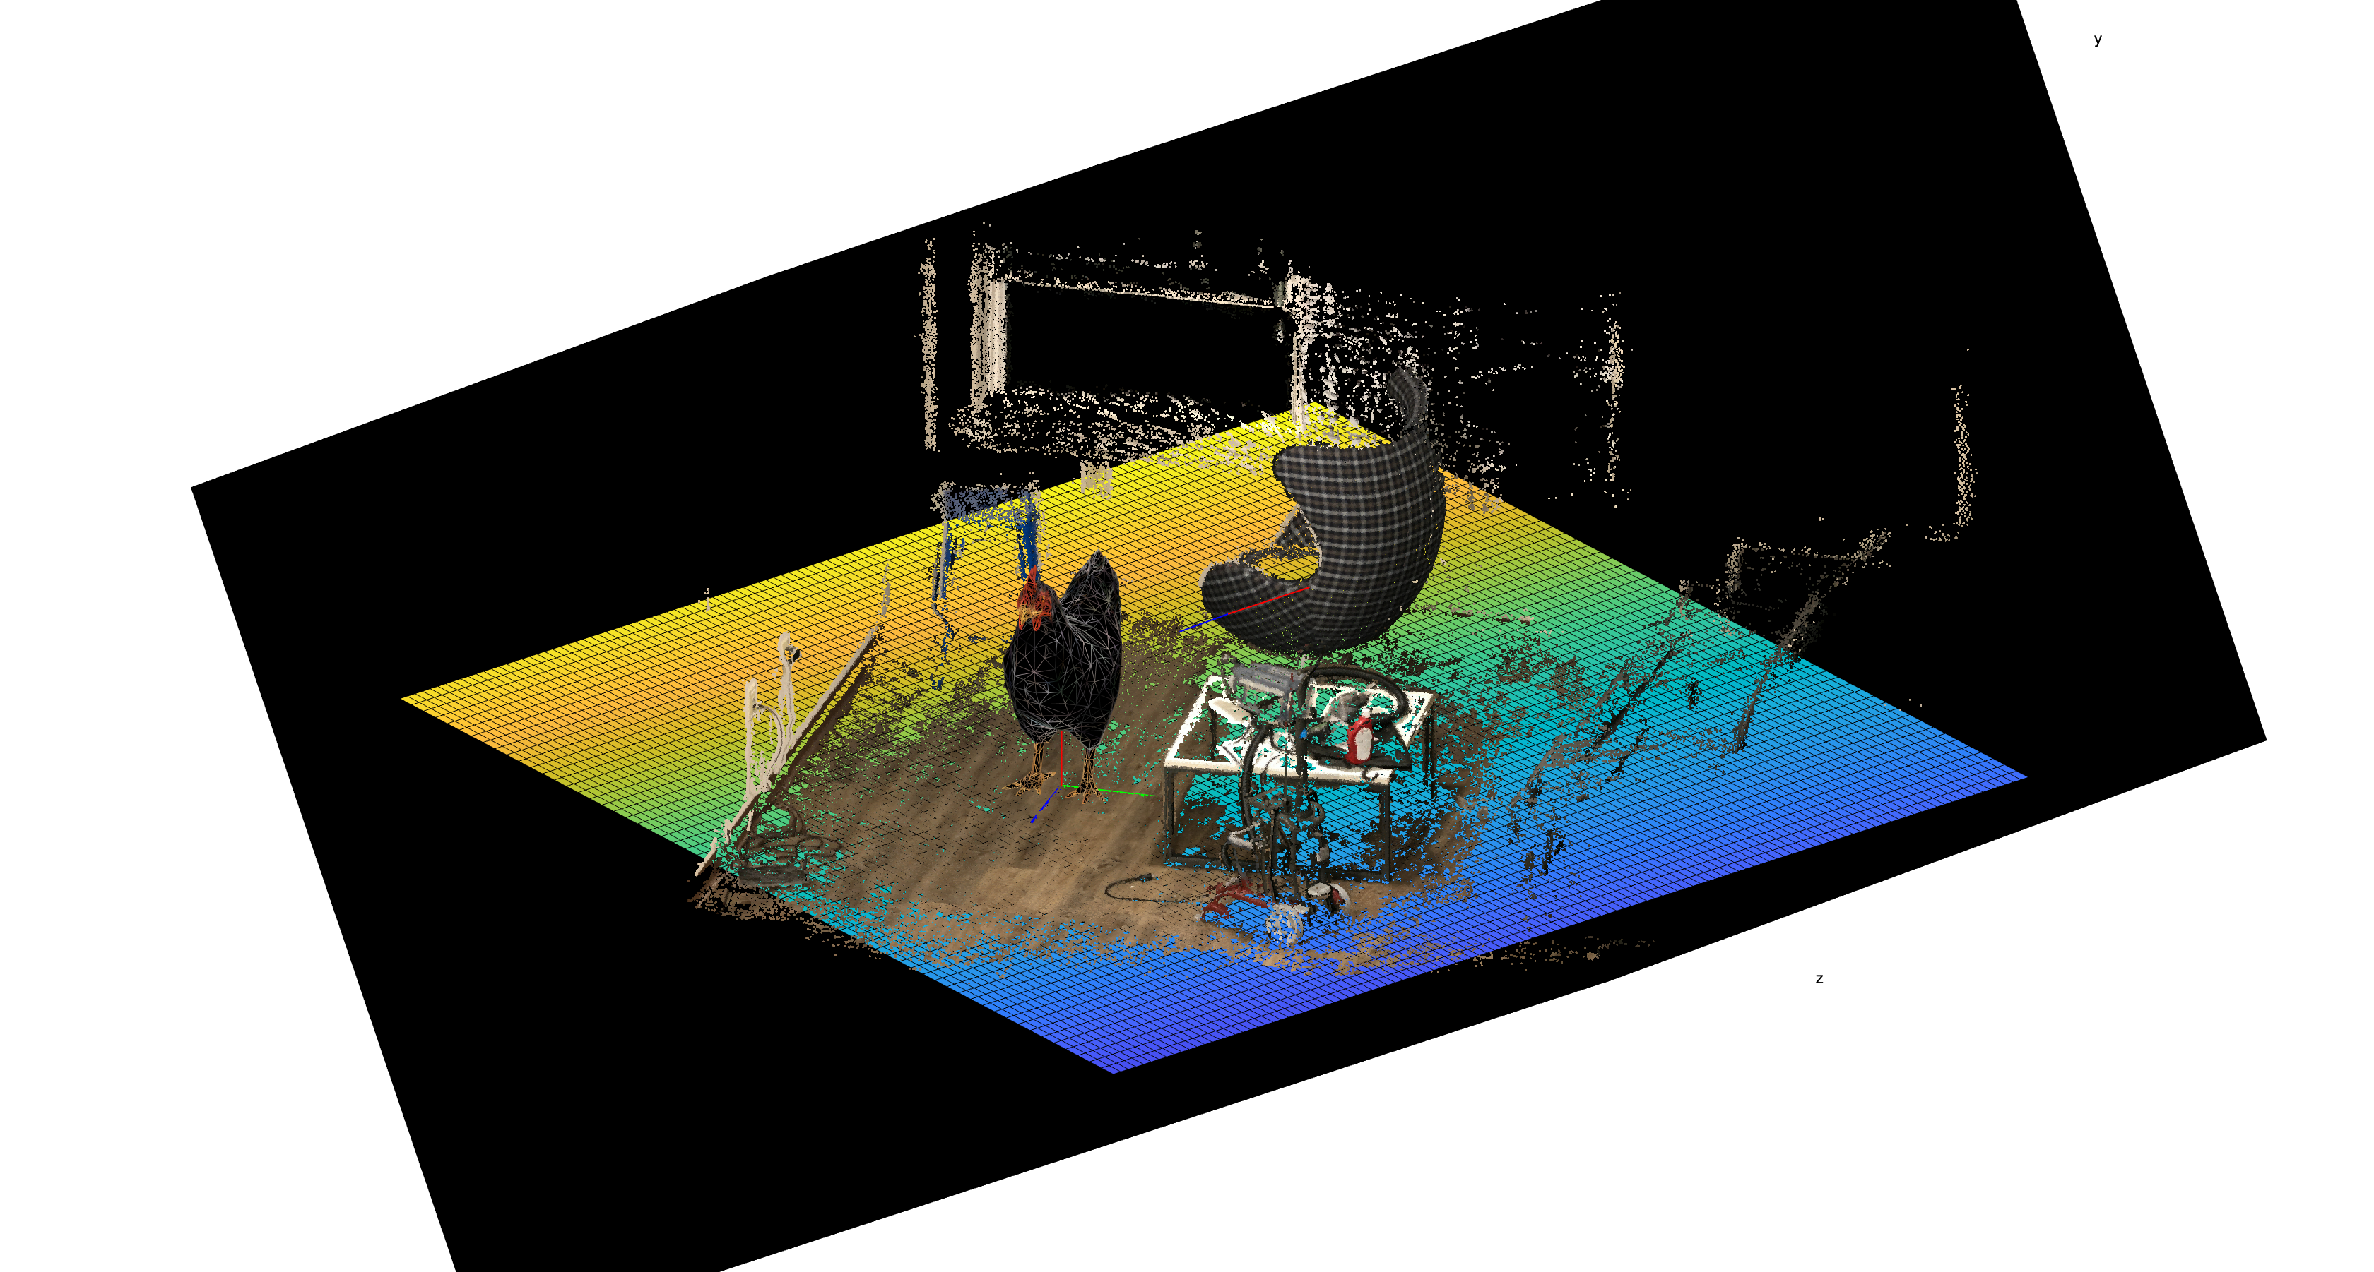
2. Design a coordinate system [Up, Forward, Left] at the position [2 1 7.3387] on the dominant plane where we want to put the object.

Slide 17
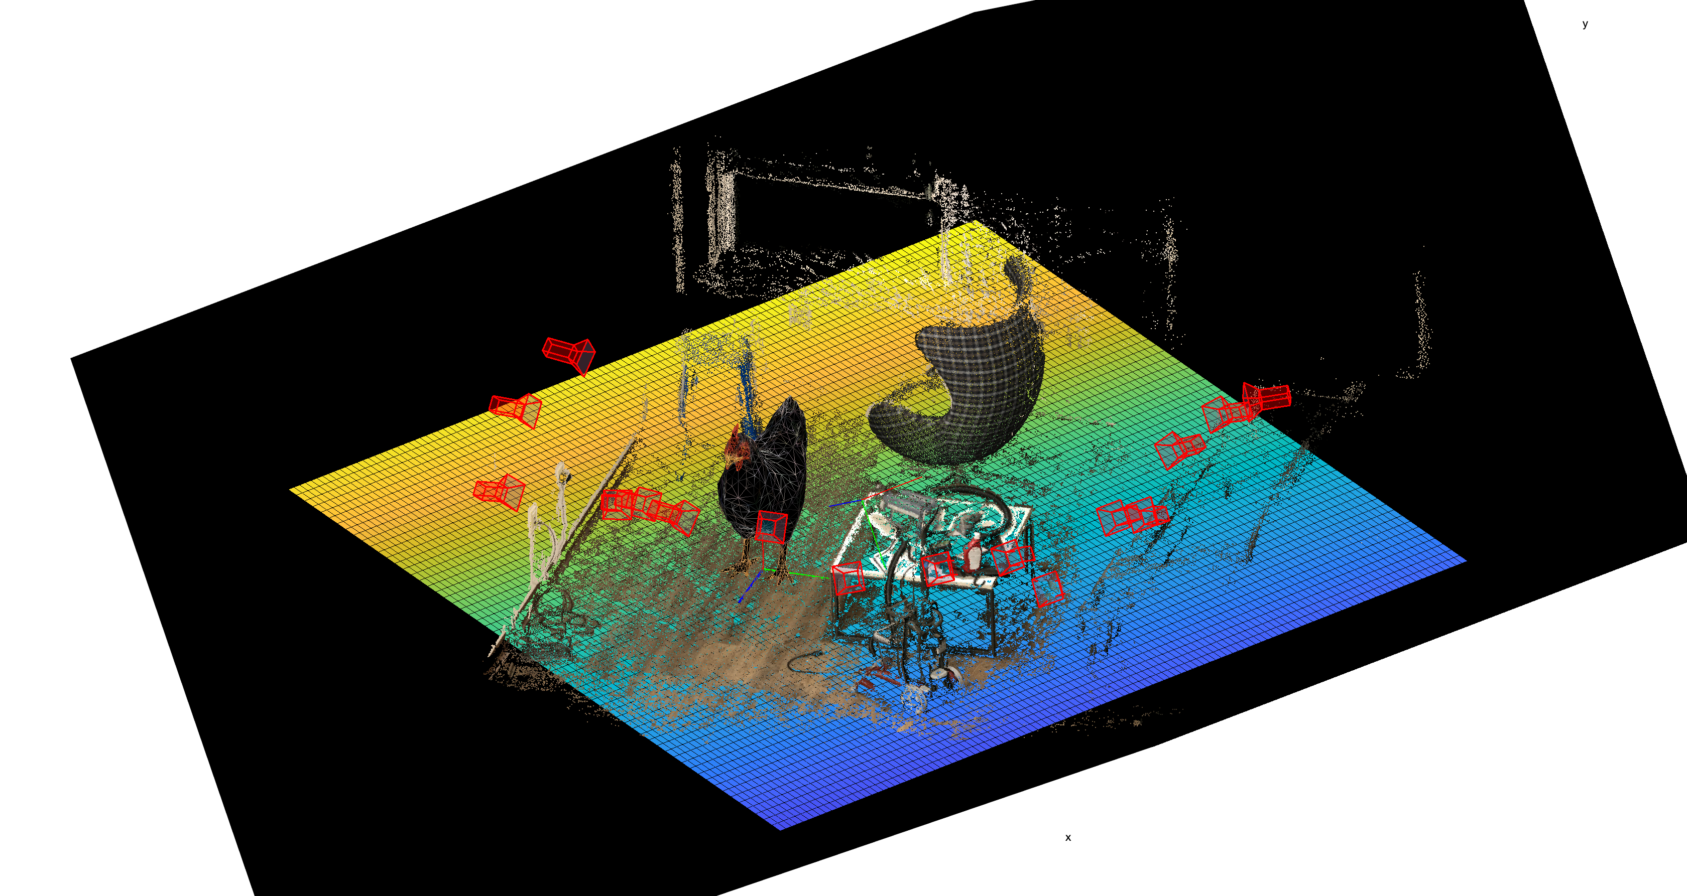
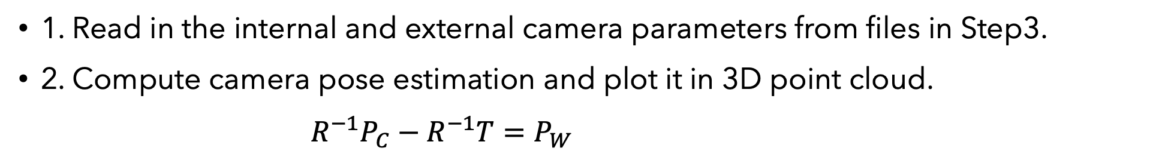
Welcome to the “augmented reality” part~
Step 8: Compute and Plot Camera Pose
1. Read in the internal and external camera parameters from files in Step3.
2. Compute camera pose estimation and plot it in 3D point cloud.
$R^{−1}P_{C}−R^{−1}T=P_{W}$

Slide 18
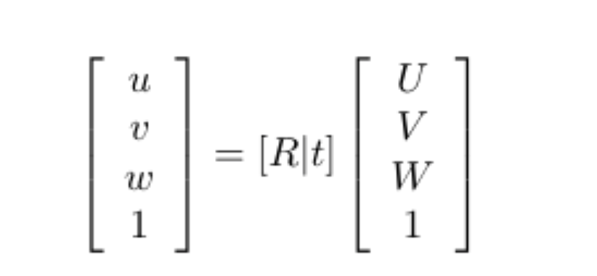
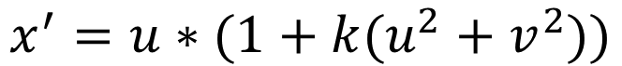
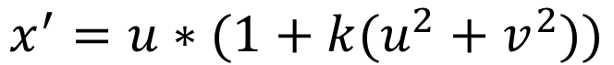
Step 9: Projection from 3D to 2D
1. We use simple radial camera model. Here is the Projection transformation.
2. The correction of distortion from world system [u ,v, w] to [x’, y’, 1].
$$x^{′}=u∗(1+k(u^{2}+v^{2}))$$
$$x^{′}=u∗(1+k(u^{2}+v^{2}))$$

Slide 19
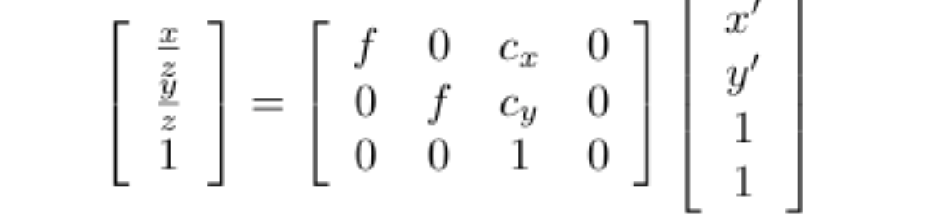
3. Project the camera coordinate system to 2D image coordinate system. The projection matrix:
Problem: The object we put in the scene will block the points behind it from the viewer in the real world.
Solution: Apply a method based on Z-buffer concept to sort the points.

Slide 20
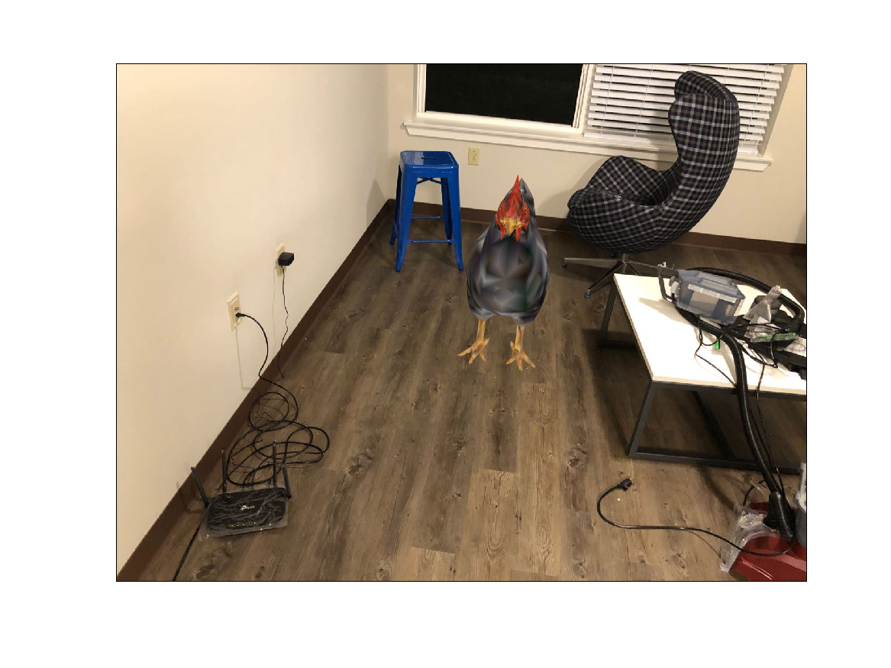
Projection Result of Virtual Object

Slide 21
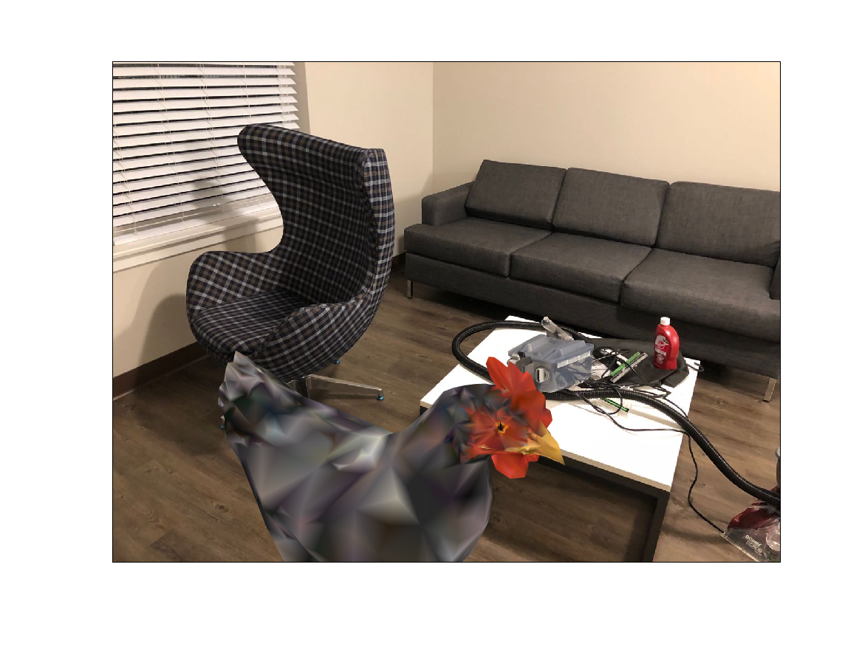
Projection Result of Virtual Object

Slide 22
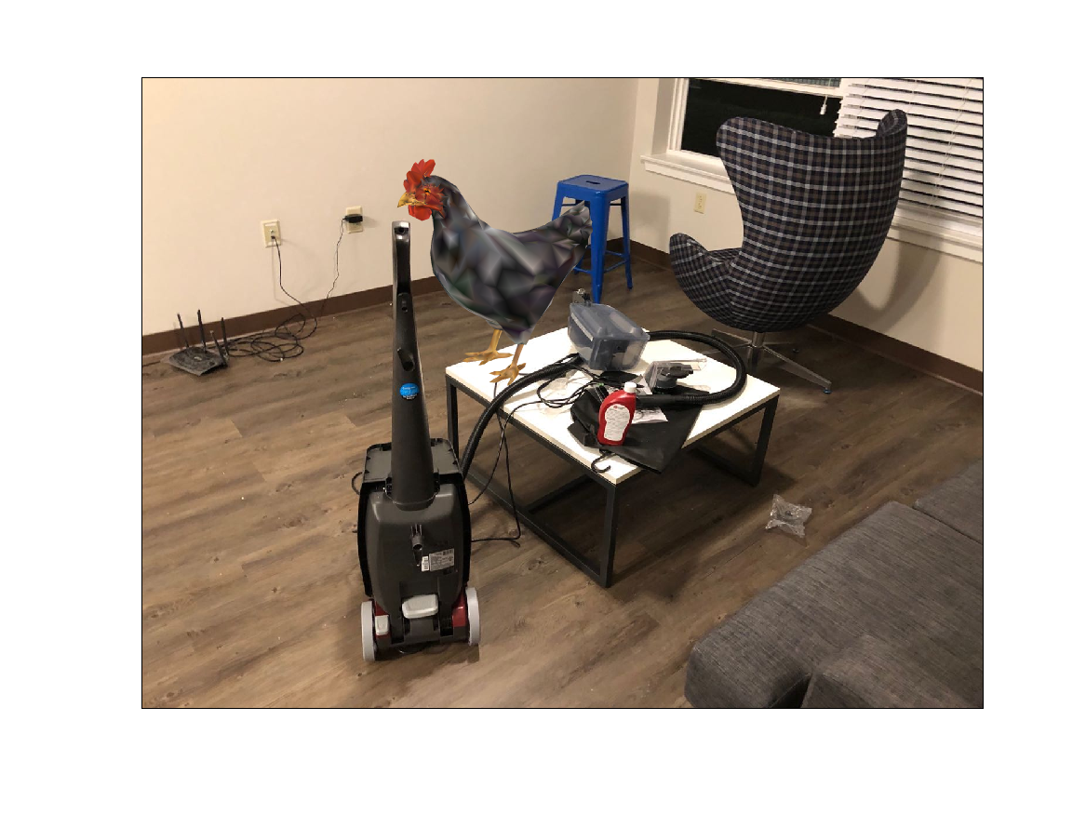
Projection Result of Virtual Object

Slide 23
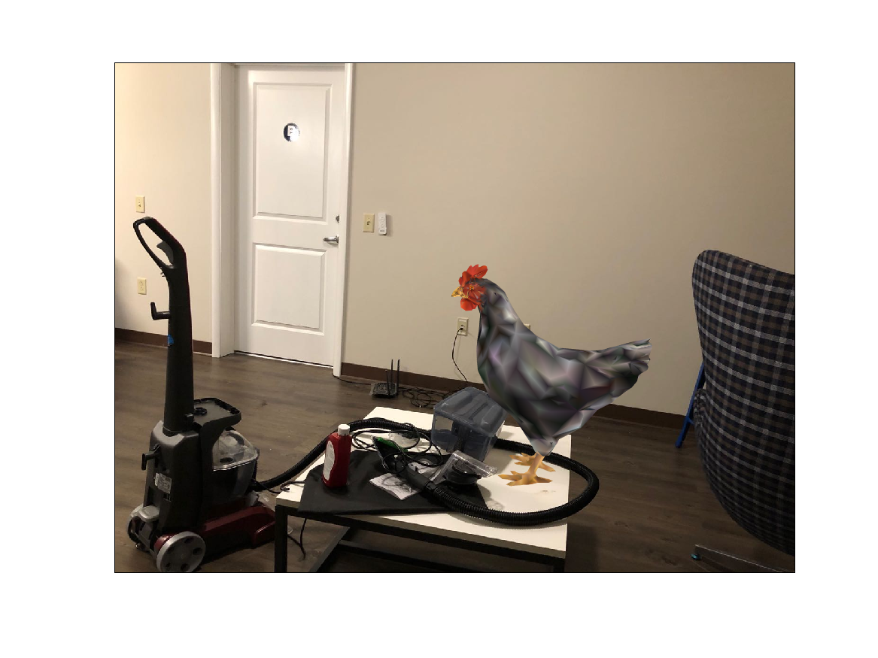
Projection Result of Virtual Object

Slide 24
Division of Works
Team members:
Shimian Zhang : Code of Projection part
Hong Zhang : Code of scene reconstruction and object placement part
Wenxing Cao : Report written
Yaqi Xu : PPT written

